Slide 1
Wind power forecasting for the day-ahead energy market ENS Data Challenge 2020 Challenge Provider: Compagnie Nationale du Rhône
Emile NAFFAH

Slide 2
Project context

Slide 3


Data challenge platform launched by the ENS (Ecole Normale Supérieure)
ENS Data Challenge: A public data challenge platform with many interesting projects provided by top companies
CNR is one of France’s leading renewable energy producers
Easy to access supervised machine learning datasets
Current challenge focuses on wind energy
https://challengedata.ens.fr/participants/challenges/34/

Slide 4
Before we dive right in, a brief introduction to the electricity day-ahead market…

Slide 5
The day-ahead electricity market
The day ahead electricity market is a bidding market;
All renewable energy producers must provide their production forecast for D+1 on day D;
Since electricity cannot be stored at a reasonable cost: Production = Consumption at every hour (balance)
Provide forecast for D+1 at 09:00 of day D
Setting of the spot price (D+1 price) at 12pm
Day-ahead forecast period
Observed
Forecast
D
D+1
00h
09h
23h59
00h
00h

Slide 6
The day-ahead electricity market
The day ahead electricity market is a bidding market;
All renewable energy producers must provide their production forecast for D+1 on day D;
Since electricity cannot be stored at a reasonable cost: Production = Consumptions at every hour (balance)
Provide forecast for D+1 at 09:00 of day D
Setting of the spot price (D+1 price) at 12pm
Day-ahead forecast period
Observed
Forecast
D
D+1
00h
09h
23h59
00h
00h

Slide 7
Why do we need to forecast production ?
Producers need to know how much they are going to produce for:
Power grid balancing
Optimizing energy sales (trading)
Wind power producers
Observed
Forecast
D
D+1
00h
09h
23h59
00h
00h

Slide 8
Why do we need to forecast production ?
Errors in forecasting generate imbalance costs to the power grid
1
Wind power producers
1
Observed
Forecast
D
D+1
00h
09h
23h59
00h
00h

Slide 9
Why do we need to forecast production ?
Errors in forecasting generate imbalance costs to the power grid
1
Wind power producers
“Over production” is purchased at a less attractive price than the spot price
2
1
Observed
Forecast
2
D
D+1
00h
09h
23h59
00h
00h

Slide 10
Why do we need to forecast production ?
Errors in forecasting generate imbalance costs to the power grid
1
Wind power producers
“Over production” is purchased at a less attractive price than the spot price
2
In case of “under production” the producer will have to pay a penalty (or negative price)
3
1
Observed
Forecast
2
3
D
D+1
00h
09h
23h59
00h
00h

Slide 11
Why do we need to forecast production ?
Errors in forecasting generate imbalance costs to the power grid
Accurate forecasts provide a high added value to the producer!
1
Wind power producers
“Over production” is purchased at a less attractive price than the spot price
2
In case of “under production” the producer will have to pay a penalty (or negative price)
3
1
Observed
Forecast
2
3
D
D+1
00h
09h
23h59
00h
00h

Slide 12
The Challenge!

Slide 13
Goal of the challenge: Forecast day-ahead production of 6 wind farms
WF1
WF2
WF3
WF5
WF6
WF4
This is a regression problem!
The benchmark to beat: Forecasts from CNR’s own operational models

Slide 14
Let’s take a look at the data and see what we’re dealing with…

Slide 15
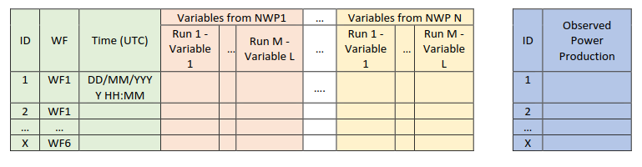
Meteorological time-series from Numerical Weather Prediction Models
Shape of data
NWP1
NWP2
NWP3
NWP4
For a given point on the grid
Wind: U (zonal) and V (meridional) components
Temperature
Total cloud cover
Training set: hourly data from May 1st 2018 to January 15th 2019
Data availability for the training set
Time of forecast 09h
Target
D-1
D+1
D
Run 00h D-1
Run 12h D-1
Run 00h D
Run 12h D
Run 00h D+1
https://www.college-de-france.fr/site/stephane-mallat/Challenges-2020.htm

Slide 16
Meteorological time-series from Numerical Weather Prediction Models
Shape of data
NWP1
NWP2
NWP3
NWP4
For a given point on the grid
Wind: U (zonal) and V (meridional) components
Temperature
Total cloud cover
Test set: From January 16th 2019 to September 20th 2019
Data availability for the test set
Time of forecast 09h
Target
D-1
D+1
D
Run 00h D-1
Run 12h D-1
Run 00h D
Run 12h D
Run 00h D+1
https://www.college-de-france.fr/site/stephane-mallat/Challenges-2020.htm

Slide 17
Meteorological time-series from Numerical Weather Prediction Models
Meteo forecasts are updated many times per day => At best, we have access to the weather forecasts generated 9 hours ago,
Hence, some meteo forecasts may be less accurate for some hours.
NWP1
NWP2
NWP3
NWP4
For a given point on the grid
Wind: U (zonal) and V (meridional) components
Temperature
Total cloud cover
Data availability for the test set
Time of forecast 09h
Target
D-1
D+1
D
Run 00h D-1
Run 12h D-1
Run 00h D
Run 12h D
Run 00h D+1
https://www.college-de-france.fr/site/stephane-mallat/Challenges-2020.htm

Slide 18
Meteorological time-series from Numerical Weather Prediction Models
Meteo forecasts are updated many times per day => At best, we have access to the weather forecasts generated 9 hours ago,
Hence, some meteo forecasts may be less accurate for some hours.
NWP1
NWP2
NWP3
NWP4
Meteo data is provided at one grid point near the WF, thus the spatial aspect of the data is reduced (lack of spatial information),
Wind production may not be correlated to meteo data at this particular grid point;
In fact, wind production is highly sensible to spatial information (terrain) => Wind is a ressource that is highly local
For a given point on the grid
Wind: U (zonal) and V (meridional) components
Temperature
Total cloud cover
Data availability for the test set
Time of forecast 09h
Target
D-1
D+1
D
Run 00h D-1
Run 12h D-1
Run 00h D
Run 12h D
Run 00h D+1
https://www.college-de-france.fr/site/stephane-mallat/Challenges-2020.htm

Slide 19
Meteorological time-series from Numerical Weather Prediction Models
Meteo forecasts are updated many times per day => At best, we have access to the weather forecasts generated 9 hours ago,
Hence, some meteo forecasts may be less accurate for some hours.
NWP1
NWP2
NWP3
NWP4
Meteo data is provided at one grid point near the WF, thus the spatial aspect of the data is reduced (lack of spatial information),
Wind production may not be correlated to meteo data at this particular grid point;
In fact, wind production is highly sensible to spatial information (terrain) => Wind is a ressource that is highly local
For a given point on the grid
Wind: U (zonal) and V (meridional) components
Temperature
Total cloud cover
Observed power production in the training set corresponds to the observed total amount of energy injected by the WF in the grid over the entire hour
Whereas meteo forecasts are provided on instants.
Data availability for the test set
Time of forecast 09h
Target
D-1
D+1
D
Run 00h D-1
Run 12h D-1
Run 00h D
Run 12h D
Run 00h D+1
https://www.college-de-france.fr/site/stephane-mallat/Challenges-2020.htm

Slide 20
My approach to the problem

Slide 21

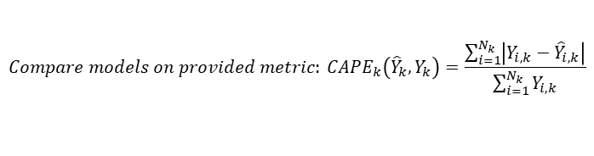
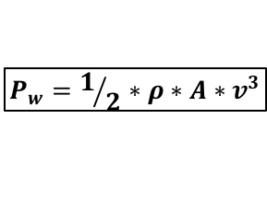
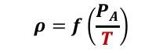
Methodology
A bit of physics first…
$$P_{w}=1/2∗ρ∗A∗v^{3}$$
For each NWP
Cubic effect of changes in wind speed
$$ρ=f\left(\frac{P_{A}}{T}\right)$$
Wind power is a highly non-linear function of wind speed
Raw data
Input: $\vec{X_{NWP}}$
Wind U component
Preprocessing
Wind speed
Day-ahead forecast
Boosted Regression Trees
Wind V component
Wind direction
Temperature
Temperature
Random Forest
Regression
Cloud cover
Cloud cover
$$Compare models on provided metric: {CAPE}_{k}\left({\hat{Y}}_{k}, Y_{k}\right)=\frac{\sum_{i=1}^{N_{k}}{\left|Y_{i,k}−{\hat{Y}}_{i,k}\right|}}{\sum_{i=1}^{N_{k}}{Y_{i,k}}}$$
Cumulated Absolute Percentage Error
Datetime
Month
hour
Choice of regression models is based on the capacity of the model to capture non-linearity and model interactions between variables with minimal preprocessing (both models generate similar results)

Slide 22
Target response to main explanatory variables
Wind power curves are highly non-linear: Small error in wind = Significant error in power

Slide 23

Can we accurately forecast wind power?

Slide 24
Forecasts are smoother than observed production and sometimes fail to capture peaks and lows (due to spatial resolution and time resolution?) However, the forecasts are accurate!
WF1
Observed
Forecast
WF2
WF3
WF4
WF5
WF6

Slide 25
There is still room for improvement!
Forecasting wind power is a real challenge:
It is necessary to rely on accurate weather forecasts;
We are limited by the delay between availability of the most recent weather forecast and the time of production forecast for some NWPs;
We have to keep in mind the fact that observed power production on hour H is the total cumulated amount injected into the grid throughout the entire hour, whereas the weather forecast is punctual;
Room for improvement:
On the data side
Spatial information and weather forecasts on a higher number of grid points around the WF may help provide better forecasts;
Include more weather variables (Humidity, Air pressure) that can impact air density;
Include planned maintenance events
Managed to beat CNR’s benchmark!
Currently ranked 19th out of 80 participants (10/12/2020),
Benchmark score: CAPE = 31.73%
My score: CAPE = 30.46%

Slide 26
Thank you for your attention!
Any questions?

